Slide 1
Dynamical Processes in Complex Networks
Term Paper - 1s
Team - 03

Slide 2
Motivation

Slide 3
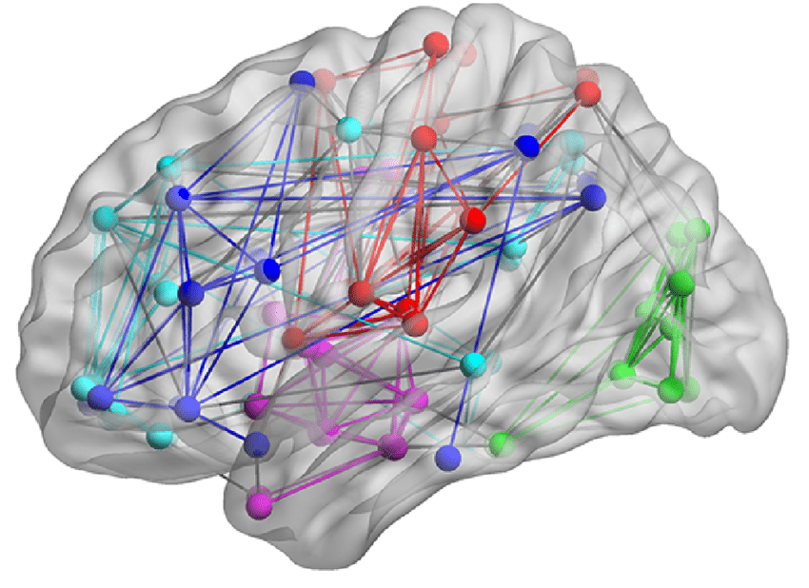
Graph Analysis for Brain Setup
Graph representations are versatile models where nodes are associated to brain regions and edges to structural or functional connections.
Structural graphs model neural pathways in white matter, which are the anatomical backbone between regions.
Functional graphs are built based on functional connectivity, which is a pairwise measure of statistical inter-dependency between pairs of regional activity traces.

Slide 4
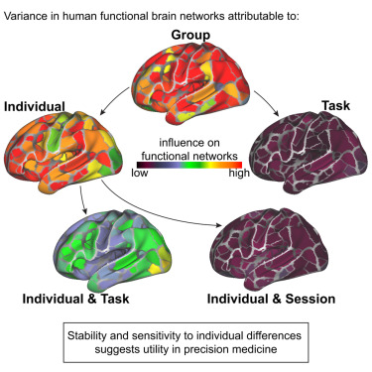
Functional Brain Connectivity
The first is that functional connectivity is purely correlative in nature. As just noted, two regions show functional connectivity, if increased activity in one region is associated above chance with activity in another.
Secondly, it can be observed that the notion of functional connectivity may pertain to any form of neurophysiological events. That is, any above-chance coincidence of brain activity signals recorded in different parts of the brain may be considered as evidence for coupling between them, which may be direct, indirect, or spurious, and hence functional connectivity

Slide 5
Dataset and Extraction

Slide 6
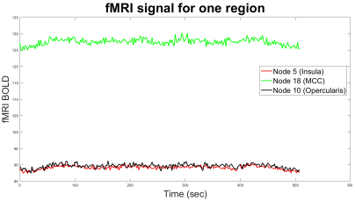
fMRI Data
Participants (22–28-year-olds) were shown two 8.5-minute emotional movies while being scanned using a 3T Philips machine.
SPM8 package was used for preprocessing and further, statistical analysis using a mass-univariate approach based on General Linear Models.
The time-series signal from voxels in areas attributed to empathy networks (ACC, PCC, MCC, Insula, Prefrontal Cortex region) was extracted and averaged.

Slide 7
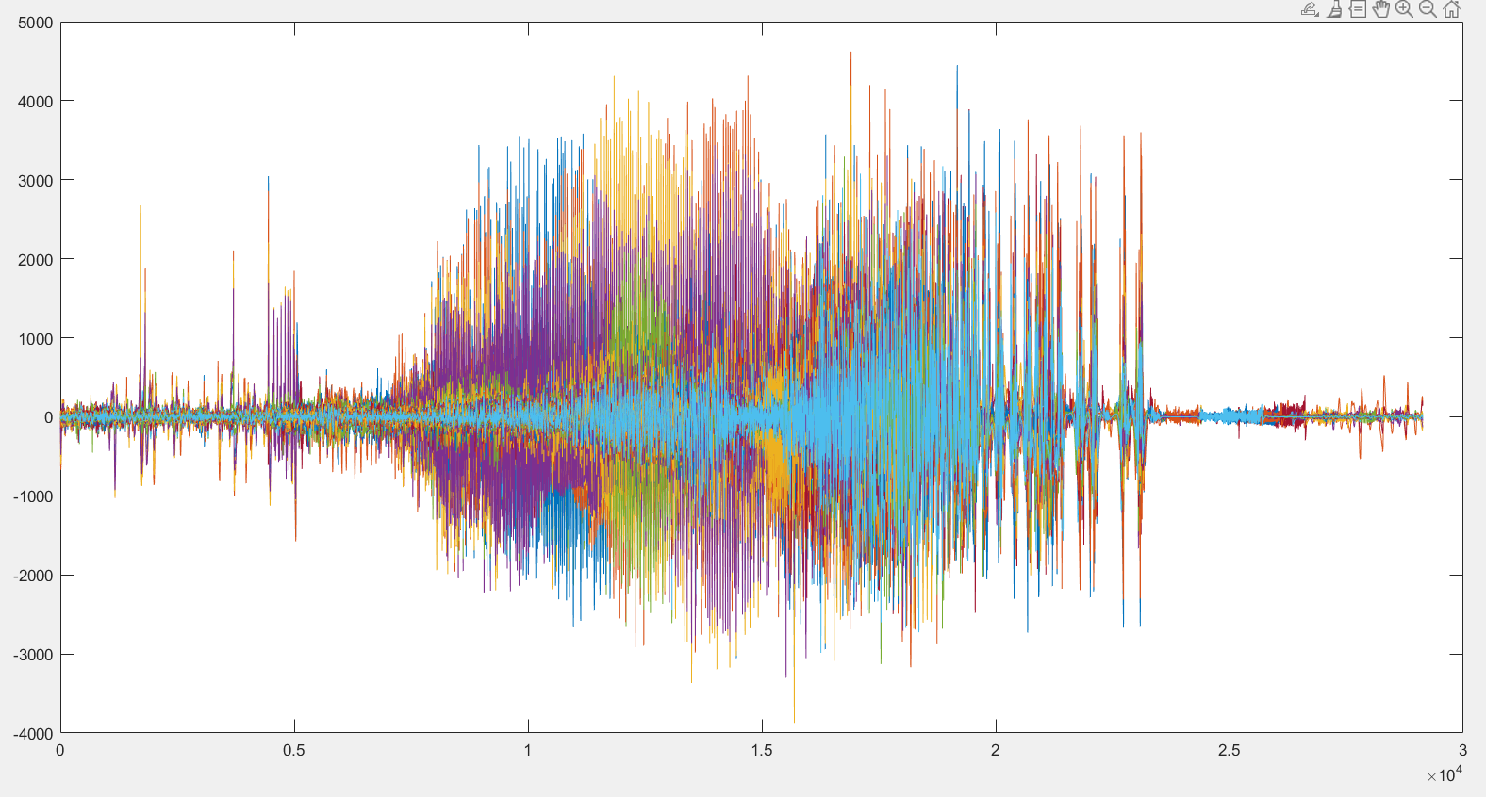
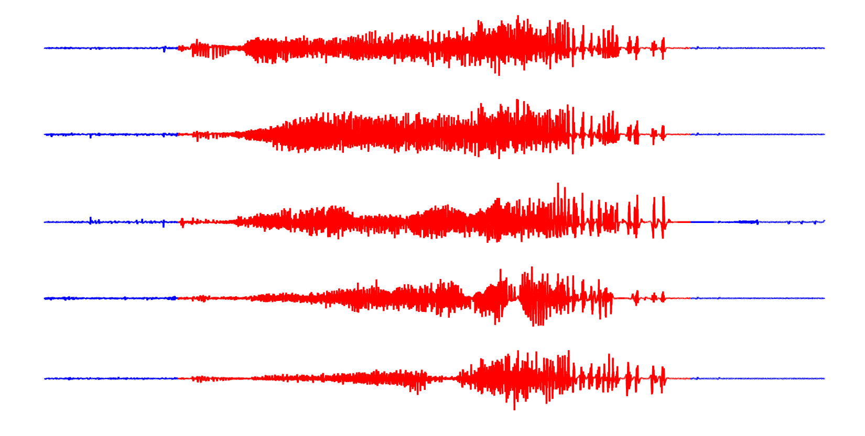
EEG Data

Slide 8
Graph Learning

Slide 9
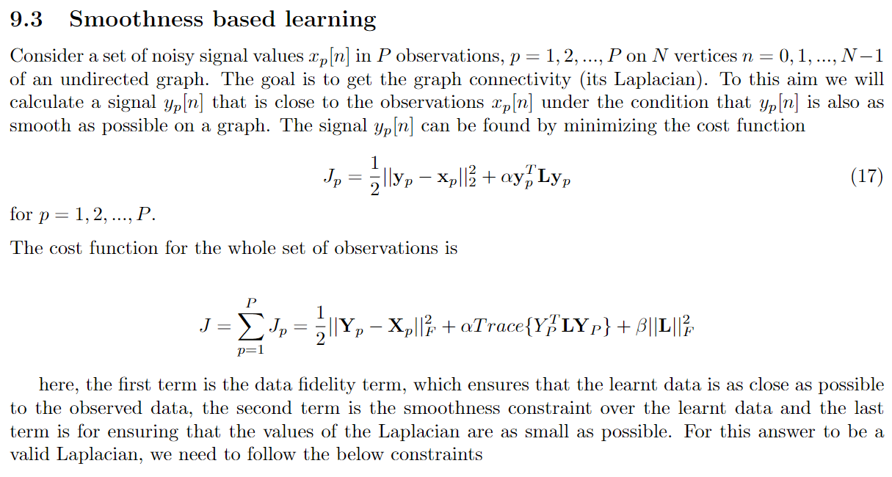
Smoothness based learning

Slide 10
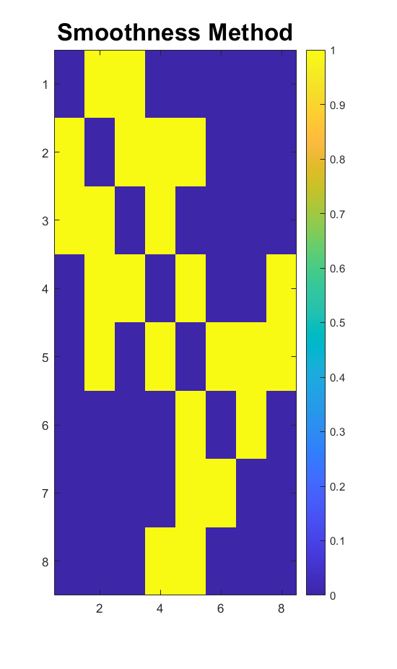
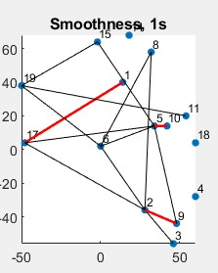
Graph Learnt

Slide 11
Network Models Employed

Slide 12
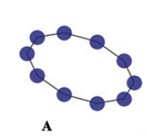
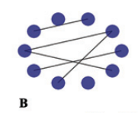
Regular Network (Ring)
Random Network
Constant Degree
Erdos-Renyi

Slide 13
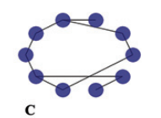
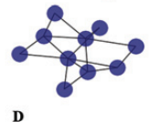
Small World Network
Scale Free Network
Small-world networks have higher clustering coefficients and shorter average path lengths compared to random networks
Network generation follows the law of growth and meritocratic connectivity, resulting in a pivotal structure, also called the core regions, that act as bridges to promote the integration of brain information

Slide 14
Parameters Modelled

Slide 15
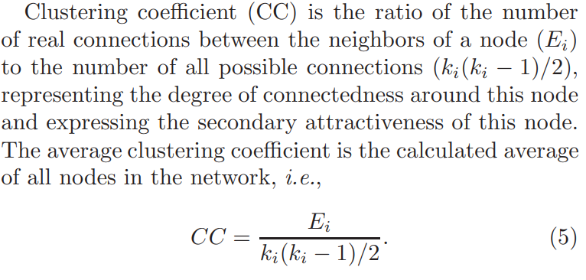
Clustering Coefficient

Slide 16
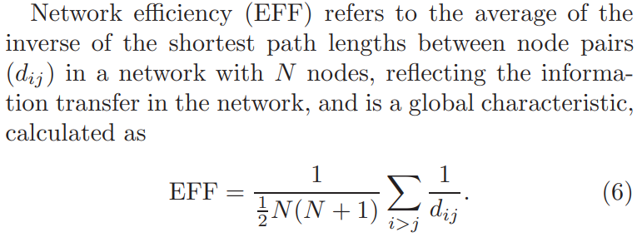
Network Efficiency

Slide 17
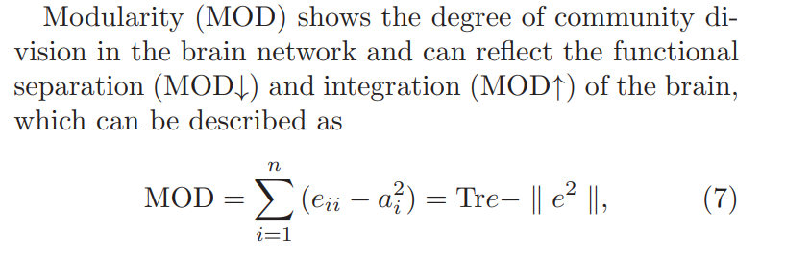
Modularity

Slide 18
fMRI Emotion Study

Slide 19
Graph Learnt
MATLAB
Smoothness Model
Window length - 16 sec
Sliding Window
Red are strongest links
Mosek solver, convex optimization

Slide 20
CC, EFF, MOD plots

Slide 21
EEG Epileptic Study

Slide 22
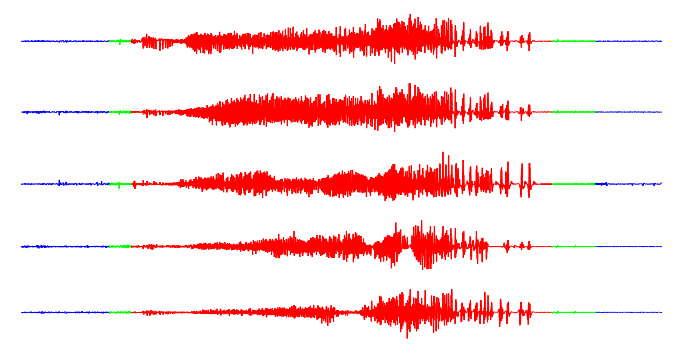
Time Windows of Interest

Slide 23
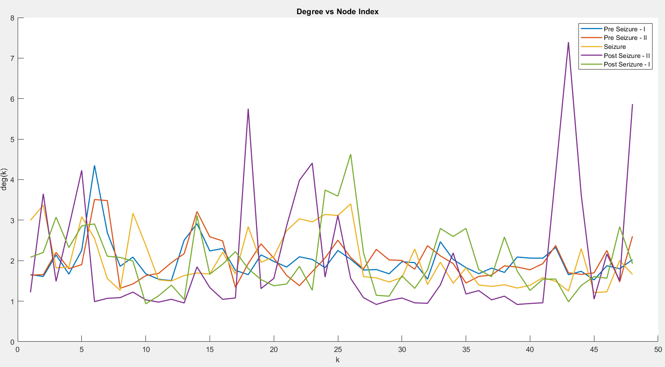
Degree vs Node Index

Slide 24
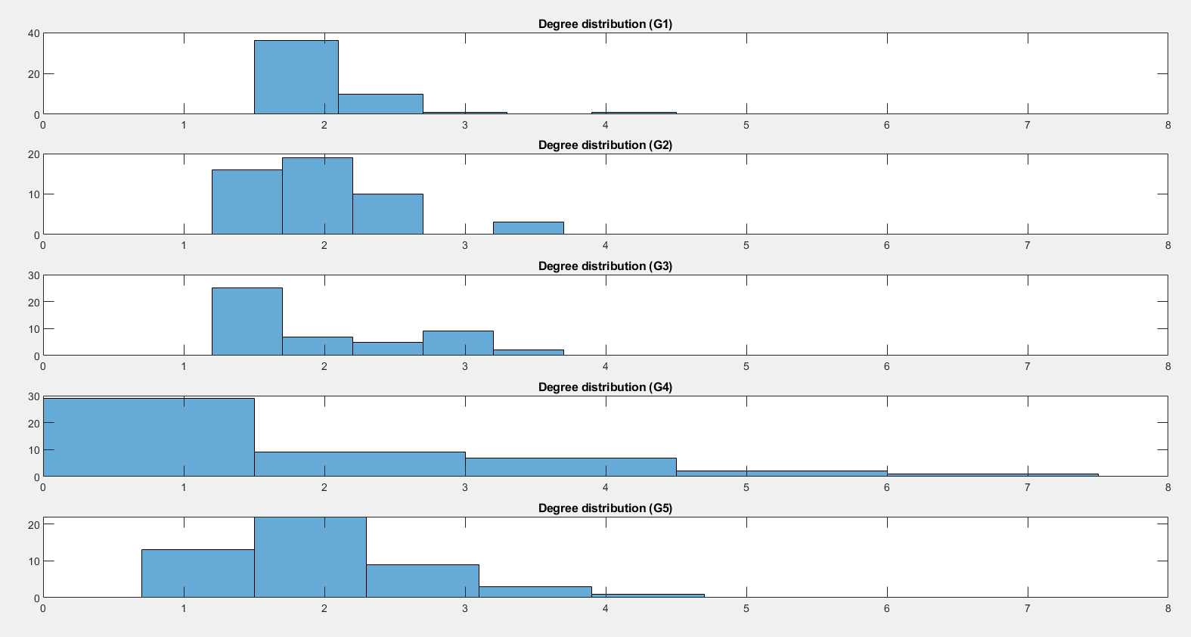
Degree Distribution

Slide 25
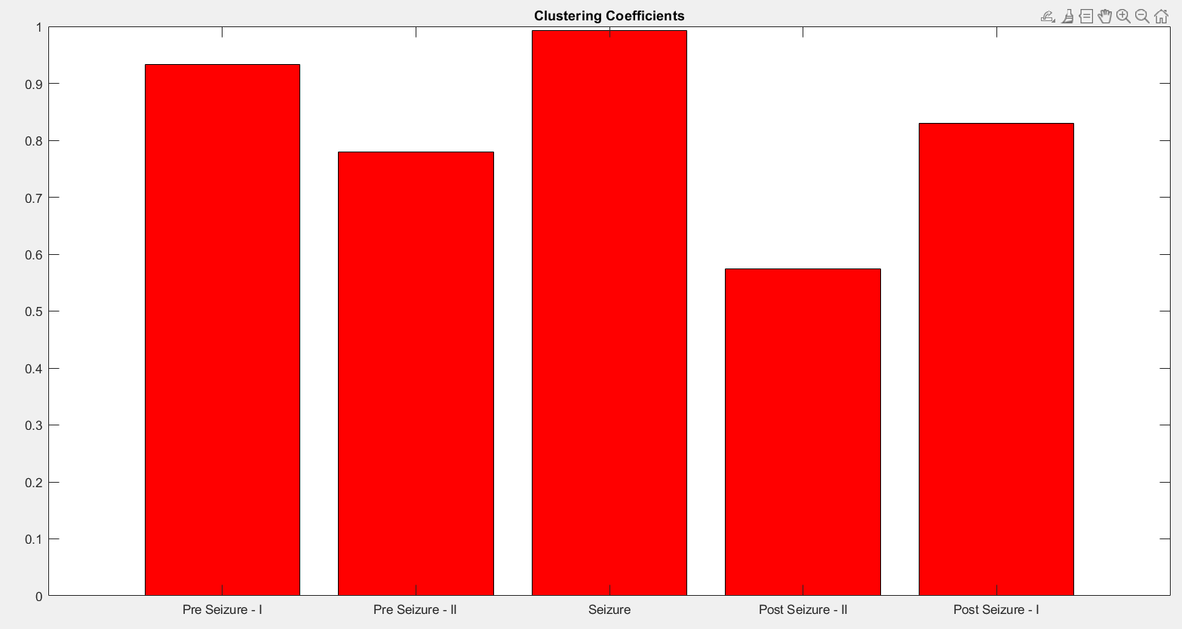
Average Clustering Coefficients

Slide 26
Current State and Future Work

Slide 27
Current State
Future Work
The paper is submitted and accepted in PubMed conference.
Work on epileptic scale free networks and device clear distinctions pre, during and post seizures through network parameters
Apply multiple graph learning methods for results variability
Try over fMRI and EEG and help identify epilepsy without having to record seizures
Identify important nodes/links for seizures through localization and beamforming techniques

